Slide 1


ETL Project: Video Game Sales
Billy Lau
Jay Cha
Chris Obonaga

Slide 2

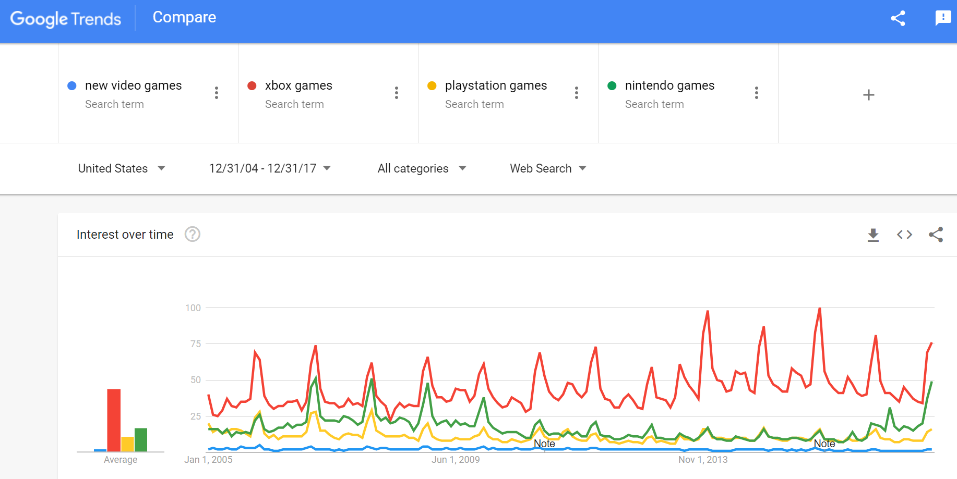
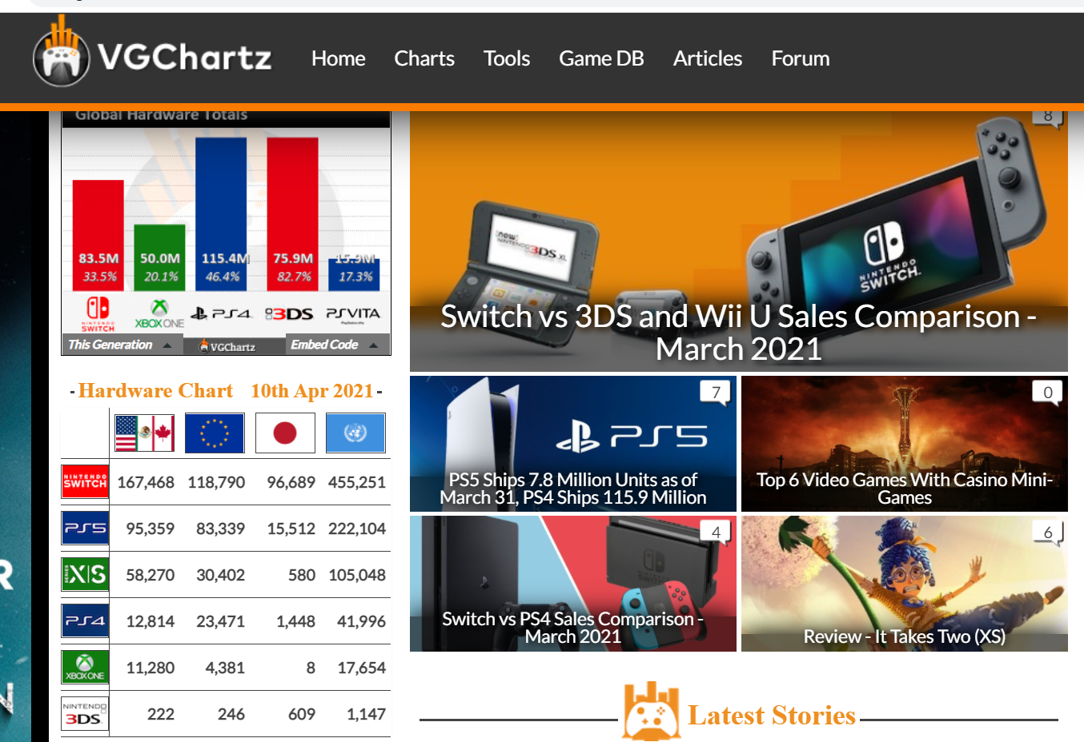
Extract
Google Trends (CSV)
Cleanup prior to pull
Web Scraping (http://www.vgchartz.com)
Too much data (>13k records)
Notes:
[Google Trend Data] Interest over timeNumbers represent search interest relative to the highest point on the chart for the given region and time. A value of 100 is the peak popularity for the term. A value of 50 means that the term is half as popular. A score of 0 means there was not enough data for this term.
2. [Global Sales Data](https://www.vgchartz.com): Scraped from a video game database website earlier, consisting over 2,000 game title data with regional sales figures and critical/user scores. Sales figures are in Millions.

Slide 3
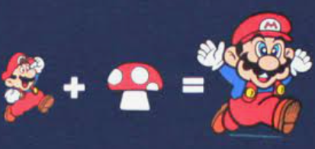
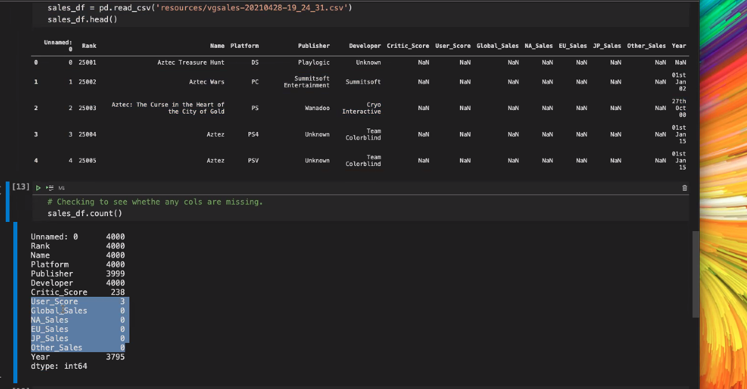
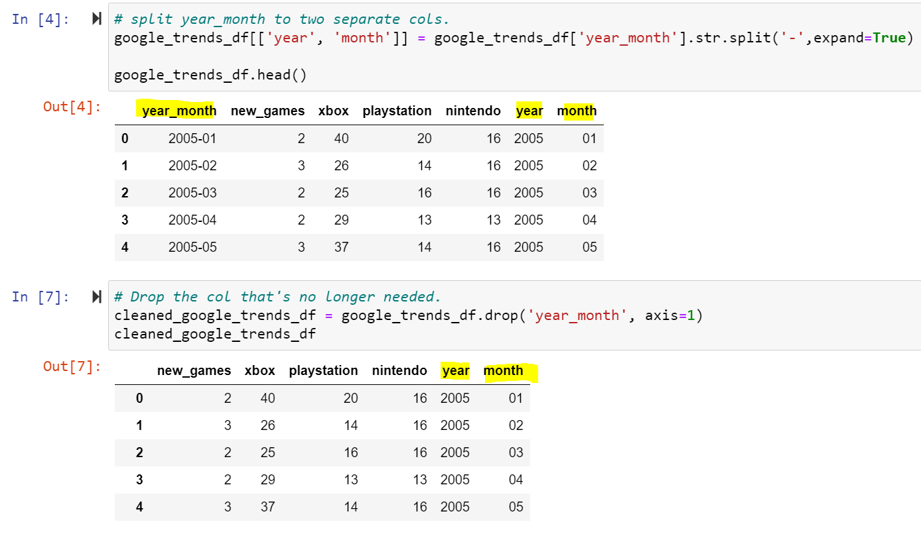
Transform
Data Cleanup
Data imported into Pandas Dataframes
Dropping “NaN”
Changed date “yyyy-mm” to individual columns for “yyyy” and “mm”
Remove embedded units in sales data (ie: 0.05M)

Slide 4

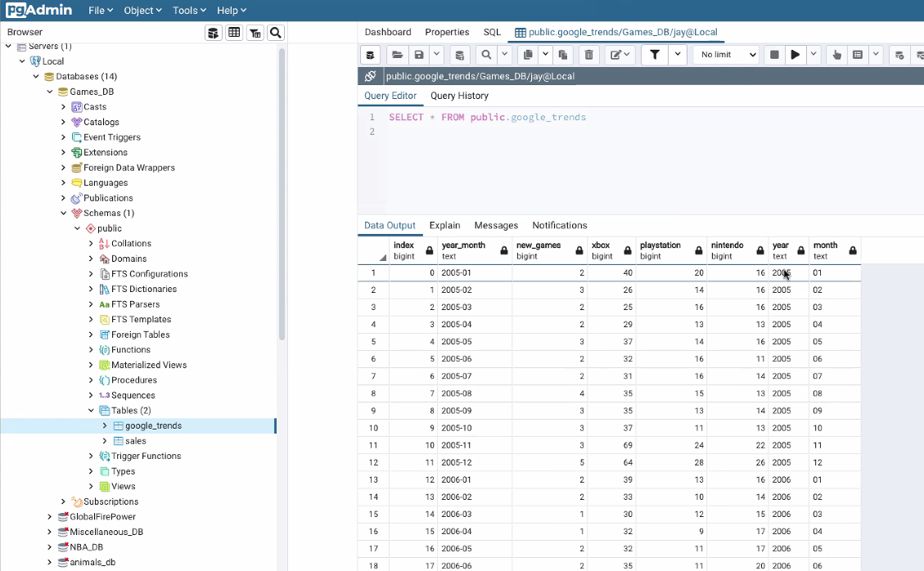
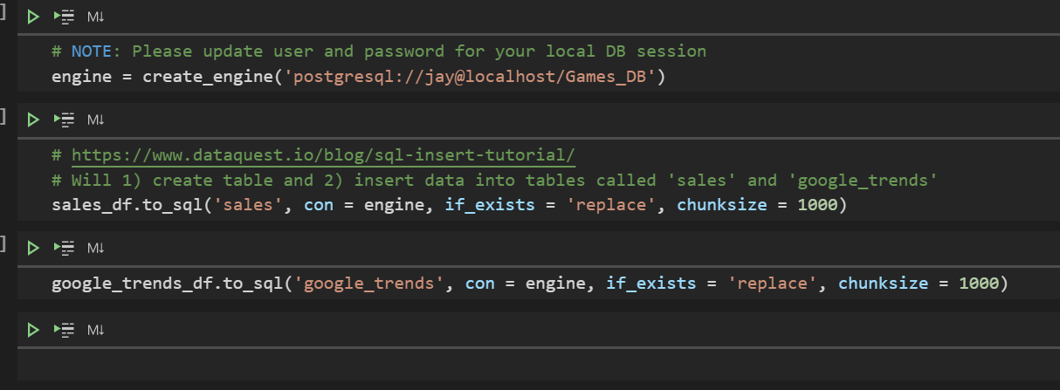
Load
PostgreSQL (RDMS)
SQL Alchemy to connect to database
Pandas to_sql method handles both database schemas and data insertion

Slide 5

Questions?

